Slide 1
My Home Automation
Paul MacDougal
TriEmbed.org
August 10, 2020

Slide 2
My Layout
Internet
Cable
Modem
ESP8266
based
devices
Ubiquity
Edgerouter
Amazon
DASH
buttons
192.168.2.x
subnet
Raspberry Pi
Zero WiFi
WiFi
AP

Slide 3
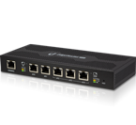
Edgerouter
https://www.ui.com/edgemax/edgerouter-poe/
1 million packets per second
24V/48V Passive PoE (not currently in use)
5 ports configured like this:
WAN
192.168.2.x subnet
192.168.0.x subnet
192.168.0.x subnet
192.168.0.x subnet

Slide 4
DHCP
Edgerouter handles DHCP for all devices. Static mapping set for each device based on MAC address.

Slide 5
DNS
Edgerouter runs local DNS (dnsmasq) to allow accessing devices by name rather than IP address.
Amazon DASH button desires access to dash-button-na.amazon.com
Local /etc/hosts file spoofs IP address of dash-button-na.amazon.com to IP address of Raspberry Pi Zero. (Thanks Huan Truong)

Slide 6
Wireless MAC filtering
The AP does MAC filtering on all devices.
Requires knowing the MAC address of each allowed device and editing the AP settings before connection is allowed.

Slide 7
MQTT
Raspberry Pi Zero W runs MQTT broker
sudo apt-get install mosquitto
sudo apt-get install mosquitto-clients

Slide 8
Smart Plugs
Sonoff S31 ($18 15A energy monitoring)
Gosund WP3 ($6 10A)
Reflashed with Tasmota firmware

Slide 9
Tasmota
Open source firmware for ESP8266 based devices.
The M in Tasmota stands for MQTT
Devices publish telemetry and subscribe to command topics

Slide 10
Washer monitor
Sonoff S31 device flashed with Tasmota

Slide 11
Washer monitor (cont)
pubs to MQTT topic: tele/sonoffE/SENSOR
{ "Time":"2020-06-28T18:59:45", "ENERGY":{ …, "Voltage":121, "Current":0.049 } }

Slide 12
Python script on Pi
Subscribes to local MQTT broker topic: "tele/#"
Publishes select values to Adafruit
def on_message(client, userdata, msg):
. . .
elif u'tele/sonoffE/SENSOR' == msg.topic:
data = json.loads(msg.payload)
publishAdafruit('h.w', data['ENERGY']['Current'])
publishAdafruit('h.wv', data['ENERGY']['Voltage'])

Slide 13
io.adafruit.com
Notes:
Mosquitto does not retain topic messages, so we send them on to io.adafruit.com, which keeps around 30 days (60 for paid account) worth of data.

Slide 14
Smart Washer
So far, we just log the data. I want to know when the cycle has finished. Need a monitor of some sort.
D1 mini subscribes to local MQTT broker topic: "tele/sonoffE/SENSOR"
Looks for the drop at the end of the final spin and beeps the buzzer.

Slide 15
Status Device

Slide 16
Status Display
Washer Idle Off
Laser Off
Time
Irrigation Off
Garage Door closed

Slide 17
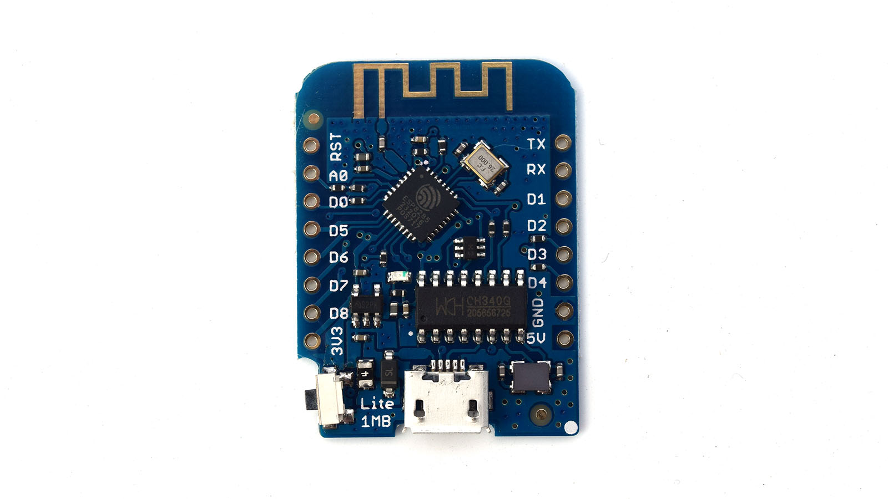
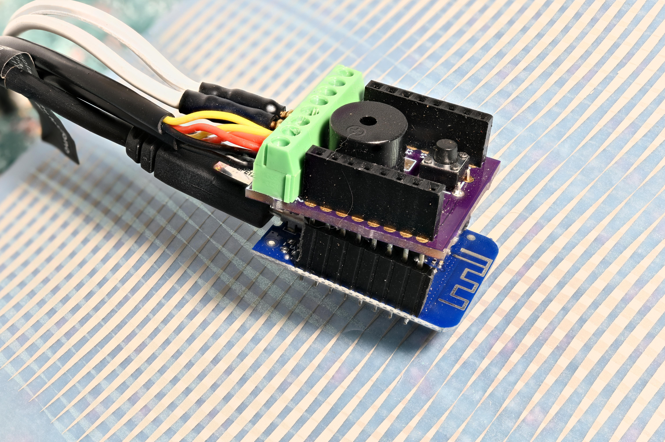
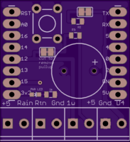
Garage Monitor
D1 mini Lite with custom shield for Dallas one-wire devices.
Notes:
D1 mini Lite has ESP8285 with 1M Flash internal to the processor chip.

Slide 18
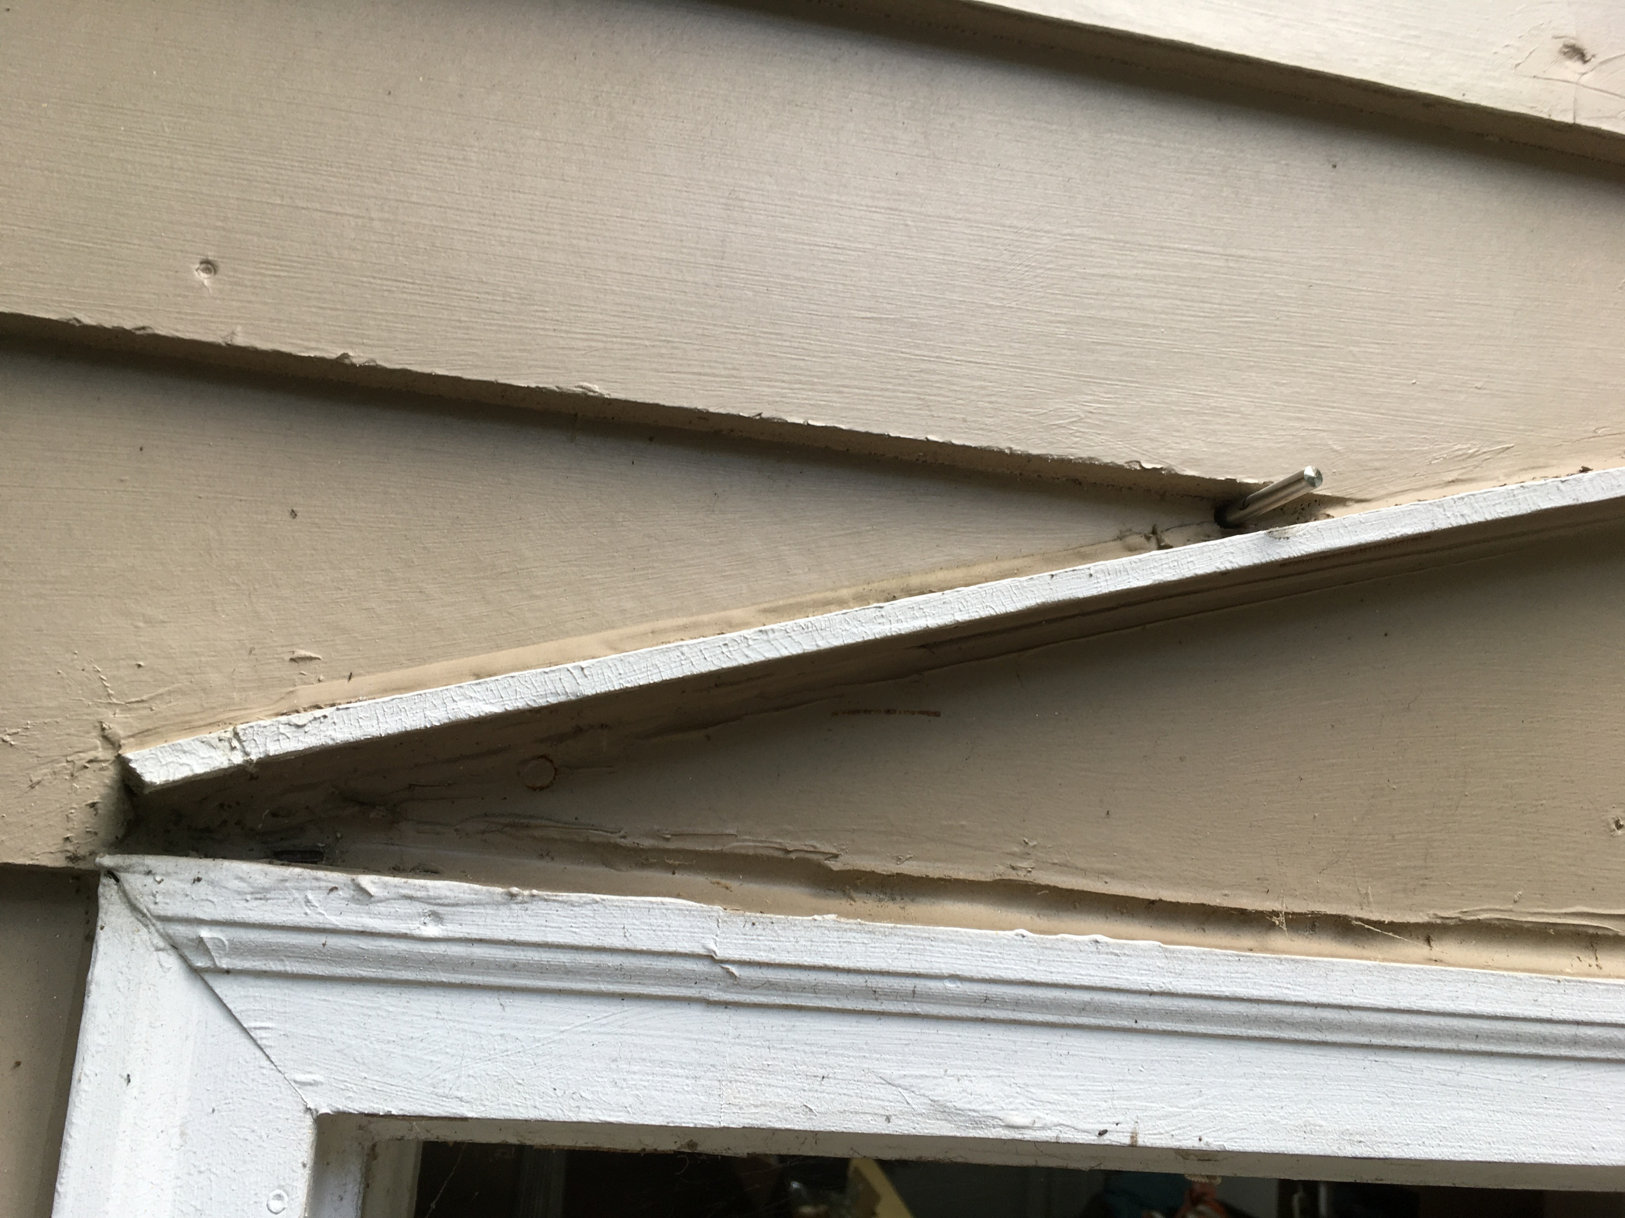
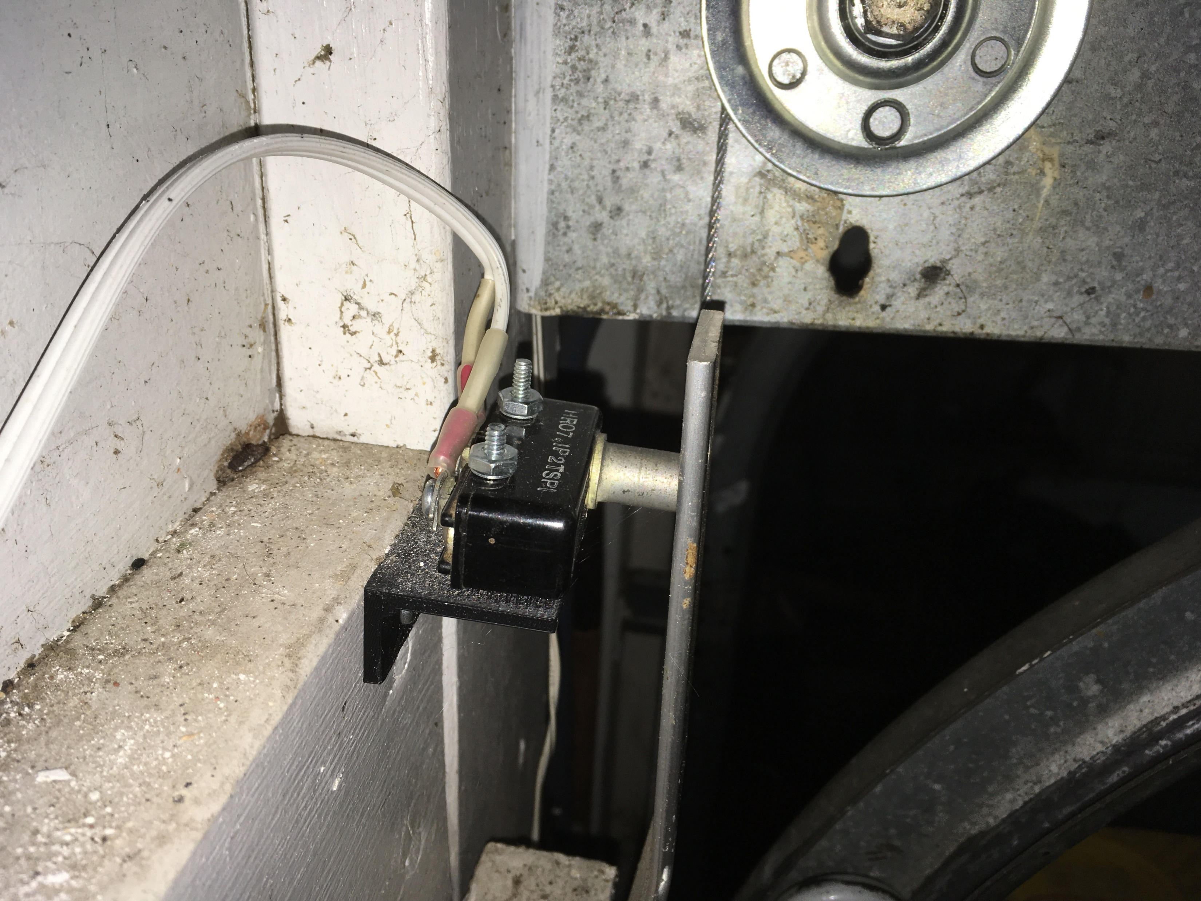
Garage Monitor (cont)
Temperature probes inside and outside of garage
Switch on door.

Slide 19
Garage Monitor
Publishes a JSON message to MQTT topic: tele/<device id>/SENSOR
{ "Sketch":"esp_garage_door_temp v1.2", "T0":824, "T1":932, "SQ":-59, "door":0, "doorCount":1555, }
Notes:
SQ is RSSI (Received Signal Strength Indicator) of WiFi connection
Door count is saved in EEPROM. It is the number of rising/falling edges seen on the door switch (debounced).

Slide 20
Garage Data
Notes:
This is a dashboard from io.adafruit.com

Slide 21
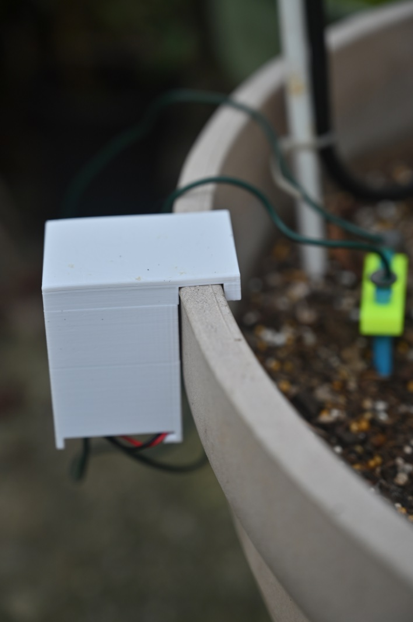
Soil Probe
D1 mini Pro w/ Lipo battery
Awakens from deep sleep, measures A0 voltage, and sends data

Slide 22
Time is energy
Using standard WiFi connection takes around 6-7 seconds to publish MQTT topic.
ESP-NOW is a vendor specific protocol that can send data in less than 0.5 sec of awake time.

Slide 23
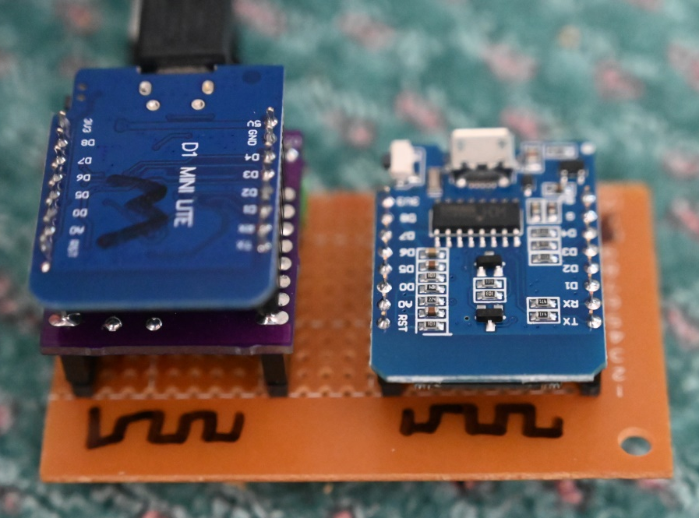
Soil Probe (cont)
ESP-NOW monitor running on D1 mini receives packet from soil probe.
Uses softwareSerial to communicate with another D1 mini Lite which publishes the data to MQTT
WiFi
ESP-NOW
Notes:
ESP8266 can run in either ESP-NOW or WiFi mode.
This unit is USB powered with a wall wart.

Slide 24
Gemini Board
Connect two D1 mini boards
14 → 16, 16 → 14
3v3 → 3v3, gnd → gnd

Slide 25
Soil Probe summary
D1 mini Pro sends data via ESP-NOW
D1 mini receives ESP-NOW and sends it via serial to D1 mini Lite
D1 mini Lite publishes to MQTT on Pi
Python on Pi subscribes to the topic and sends the data to io.adafruit.com

Slide 26
Soil Probe Data
Notes:
I haven’t quite figured this out yet. I think the sharp up spikes are rain/watering events.

Slide 27
Soil Probe Battery
No data
No data
Notes:
Low reading 2020/08/06 9:00:21pm 382
Low reading 2020/08/07 2:09:04am 382
Last reading 2020/08/07 6:16:08am 384
Recharge 2020/08/09 6:40:56pm 371

Slide 28
Don’t you plug in your plants?
Notes:
Charging the battery in the soil probe.
Need to react to the battery voltage getting low.

Slide 29
How reliable is it?
Notes:
Here, we see the Sonoff S31 reported voltage over a month.
I don’t see any data outages. This means the Tasmota firmware and the Pi software are running well.
This daily variation of line voltage is interesting.

Slide 30
Reliability (cont)
No data
Notes:
My custom code is not doing as well. Sometimes things stop working for unknown reasons.
I need to detect when they stop sending data. I expect data from most devices every 15 seconds.

Slide 31
To be continued …

