Slide 1
Internet of Things
Chip McClelland

Slide 2
Agenda
Problem statement
Selection criteria
Some options considered / explored
GPRS Example – Xively
WiFi Example – data.sparkfun.com
Next Up – Power and Cost optimization

Slide 3
Problem Statement
There is no shortage of cheap and ubiquitous sensors to collect data.
But…
I need to reduce the time and effort to retrieve that data and
a mechanism to quickly, continuously and automatically share it.

Slide 4
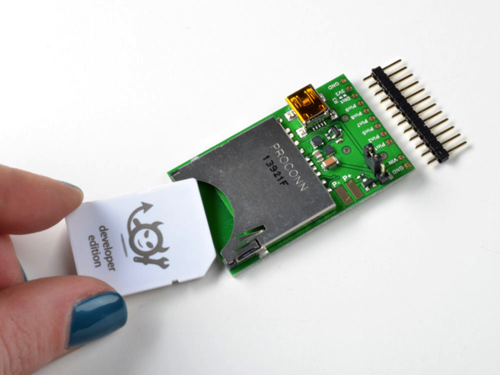
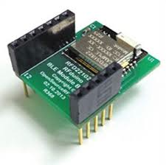
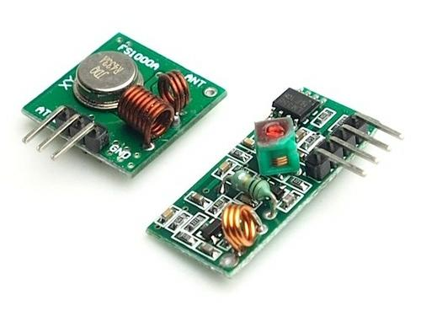
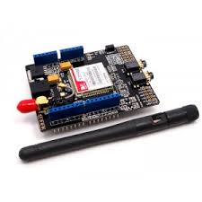
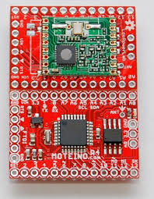
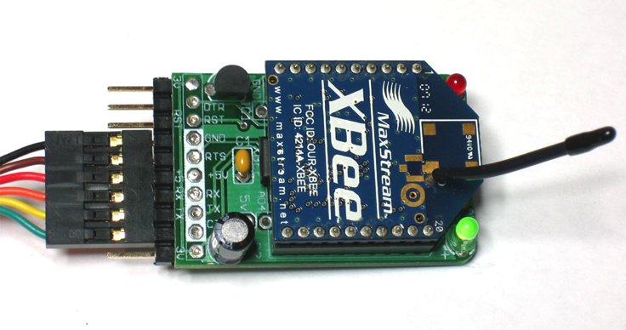
Communications Options

Slide 5
Data Service Options
Xively
Professional Internet of Things Site
Easy and free to get started
Integrated graphing – great documentation
Commercial service – not cheap
Data.Sparkfun.com
Based on open-source Phant – roll your own
Less integrated – access via .CSV and .JSON only
Public by default – unclear commercial future

Slide 6
GPRS & Xively
Pros:
Simplified design: location, time, storage
Works just about anywhere
Range of communication choices: Http, JSON, SMS
Bi-directional / ubiquitous
Cons:
Power consumption – up to 500mA when sending
Speed – GPRS service only
Can’t do SSL due to Arduino limitations
Cost - $2/day or $60/month
Communicate using SoftwareSerial AT commands - painful

Slide 7
CC3000 & Sparkfun
Pros:
Simplified design: location, time, storage
WiFi broadly available
Range of communication choices: Http, JSON, SMS
Speed / Bandwidth
Communicates using SPI Bus- Buy the Adafruit version!
Cons:
Does not work with “Captive Portal” networks!
Can’t do SSL due to Arduino limitations
Bi-directional possible but need something like DynDNS

Slide 8
Next Up
Like most embedded projects – Power and Price
Power Optimization
New power supply for both
Sleep and software control of modem
LiPoly batteries
Price
Custom board
Less expensive data services – Adafruit exploring?

